Slide 1
Sacred Heart Primary School
-
‘the best bits’
2016 17

Slide 2
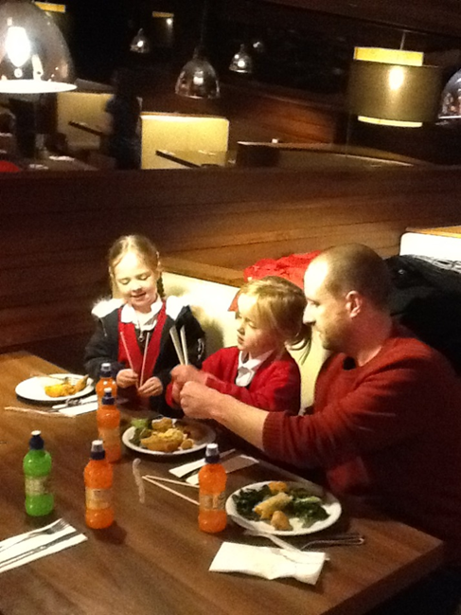
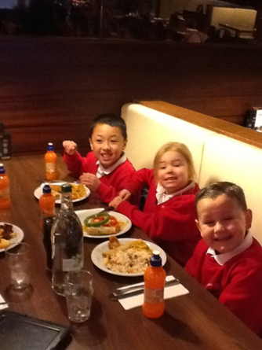
Reception Class
My daddy came to the restaurant. It was good.
To celebrate Chinese New Year we visited a Chinese restaurant to taste some Chinese food. The children all tasted some Chinese food and some even used chopsticks.
I can use chopsticks. I use them ay home.

Slide 3
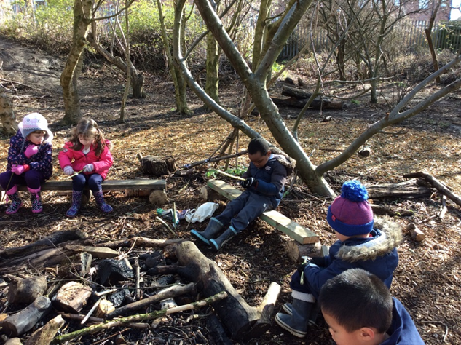
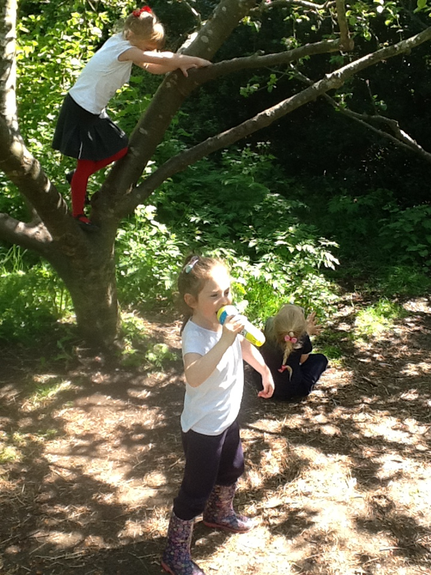
All the children in Reception Class have enjoyed their weekly Forest School sessions- climbing trees is always their favourite thing to do!

Slide 4
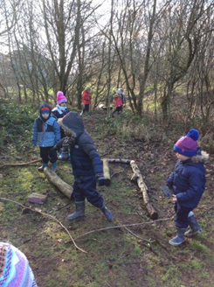
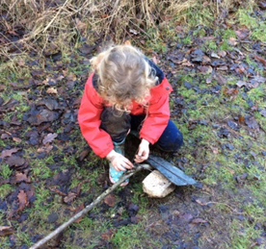
Forest School has also developed their knowledge on seasons and about the world in which we live.

Slide 5
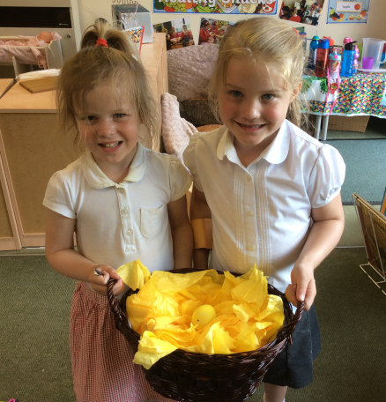
Mystery Egg
Reception had a mysterious egg turn up in their classroom. They did not know what is inside it, but they were all very excited to find out! They have been busy making predictions and some children think it could be a dragon or a dinosaur.

Slide 6
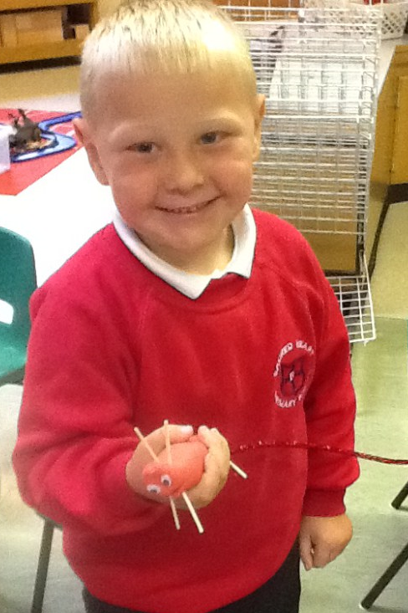
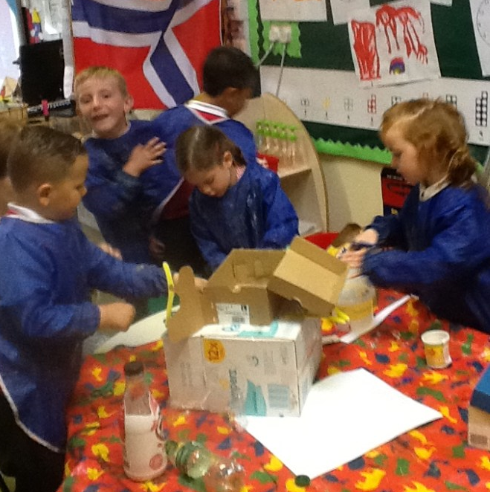
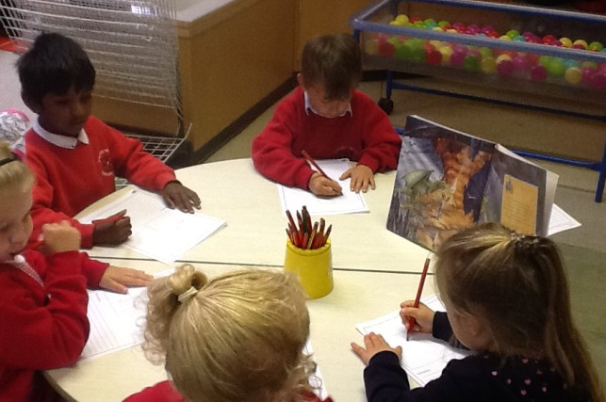
Baby Dragon
The egg turned out to be a dragon egg and the children have been taking part in all things dragon related. They made some dragons using the playdough , a house for the baby dragon and the children wanted to make some swords and shields to teach the dragon how to attack a knight.

Slide 7
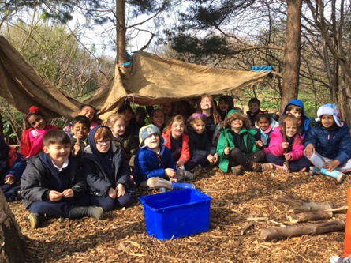
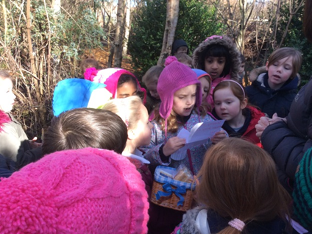
Year 1 have had a fantastic time at Forest School this year!
We loved climbing trees, running up and down the muddy bank and finding things in the forest. Our favourite memory of Forest School was discovering a basket hidden in the bushes. It had a letter and a cake inside. It was from Little Red Riding Hood! We enjoyed making dens for the wolf and hiding places for Little Red Riding Hood and Grandma. We got to eat the delicious cake later! This year we also learned how to make shelters and worked as a team.
By Kieran, Finn and Walter Y1

Slide 8
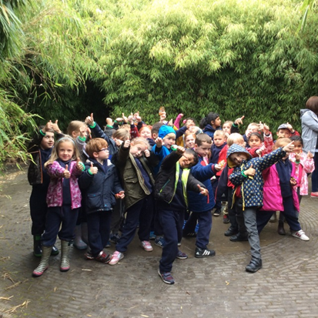
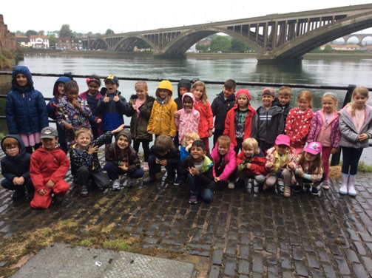
Our residential trip to Berwick was one of the highlights of our year! We loved visiting Alnwick Gardens and finding the characters on the Fairy Tale Trail. Everyone had a super time playing in the fountains! One of our favourite things about the trip was getting to have a sleepover with our friends and having some lovely food and a party.
We had so much fun making the Superhero capes with our parents. We felt like real superheroes with our capes on and we liked making our own designs. We also liked learning about other superheroes like Wonder Woman and Storm and talking about film clips we watched together.
By Erin McGarry, Barney, Isabella and Harry C Y1

Slide 9
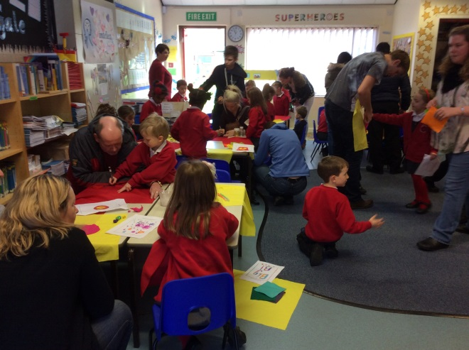
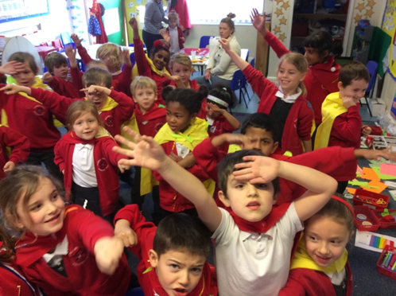
Year 1 Superheroes

Slide 10
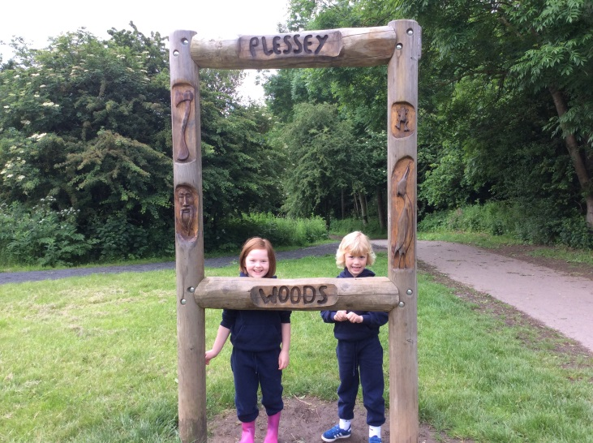
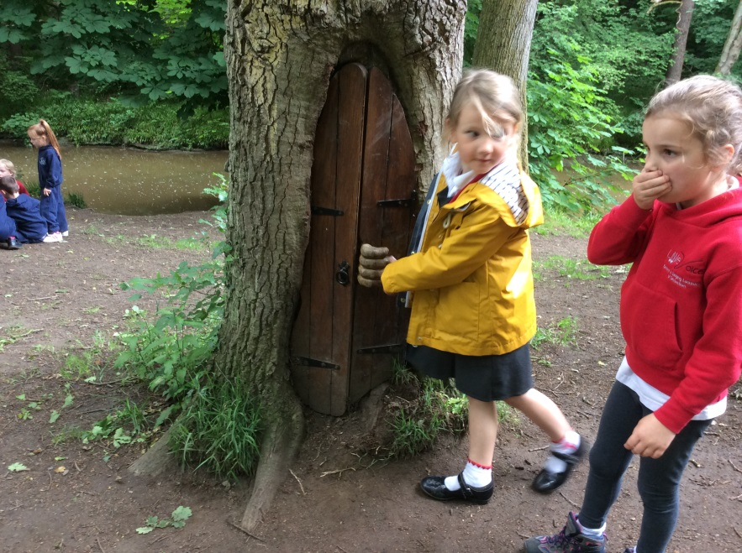
Plessey Woods was another one of our favourite trips! We discovered fairy doors hidden in the trees and tried to spy through the holes to see who was inside! It was so funny when we found Shrek’s swamp and his toilet!
By Aidan and Erin Devine Y1

Slide 11
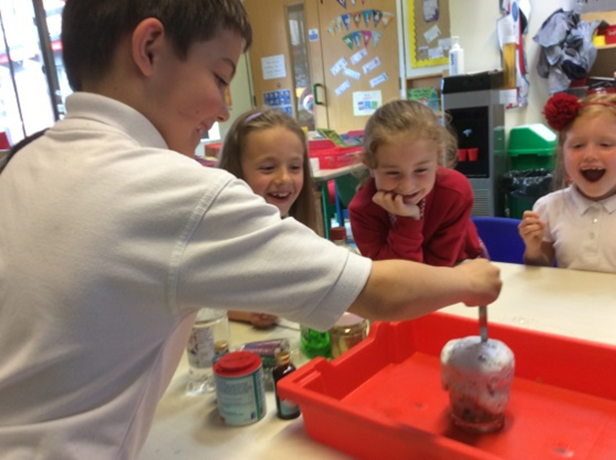
Science Week was really fun! We made fairy potions with vinegar, food colouring, washing up liquid, glitter and a secret ingredient. It was so cool when they bubbled over the sides everywhere! We also liked watching the ‘Dancing Raisins’ experiment.
By Ruby, Sam and Elsie Y1

Slide 12
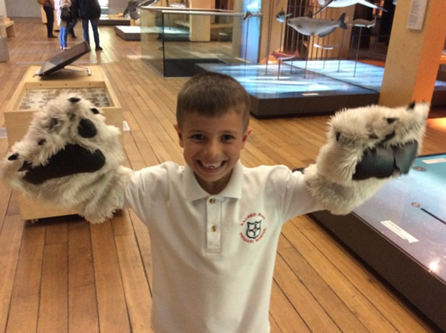
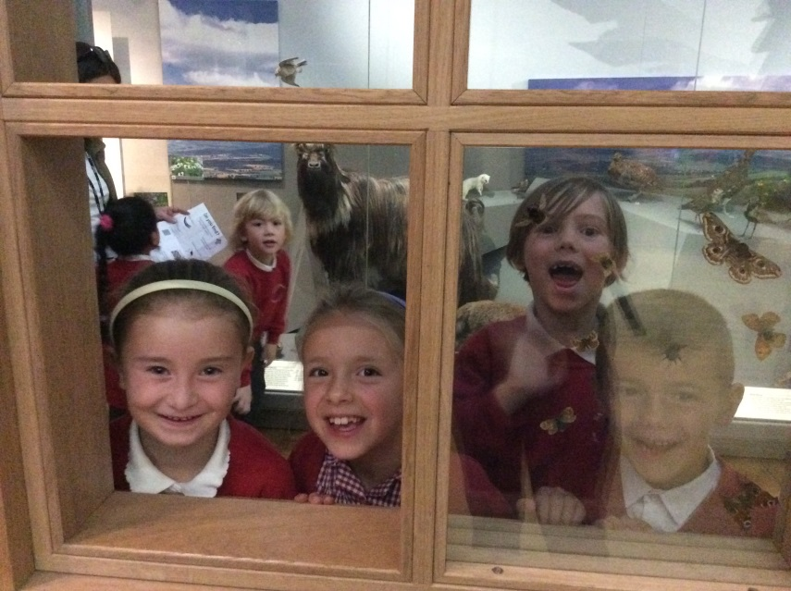
At the Great North Museum we got to dress up as different animals and talk about what they look like and what they eat. We already knew lots of animal facts from Science. We loved seeing all of the huge animals in the museum. The tiger was one of our favourites. We even got to look at some of the dinosaurs too!
By Alexa, Ben and Harry Costigan-Smith Y1

Slide 13
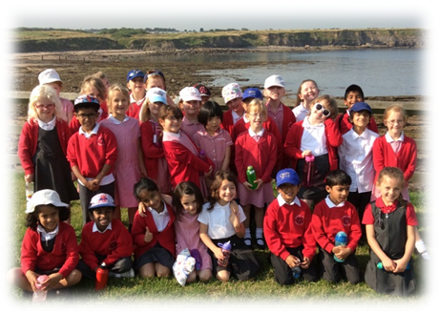
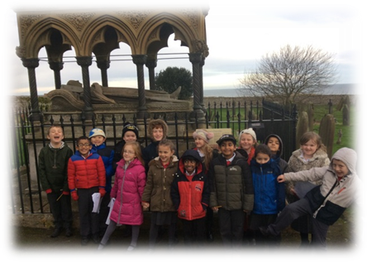
Grace Darling –We had a brilliant time in the Autumn Term
visiting the Grace Darling
museum in Bamburgh. We
went into the church yard
where Grace Darling was
buried, the church was very
old fashioned and nice!
We saw her tomb and we even got to see some of her old clothes, it was very interesting and exciting! We loved our
rescue topic and it was so fun building our own life boat during STEM week. By Thomas, Anna
and Daniel Y2

Slide 14
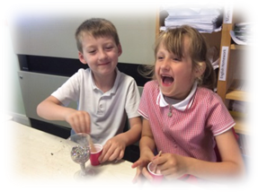
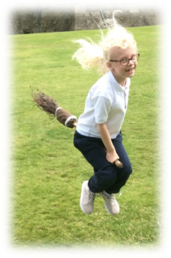
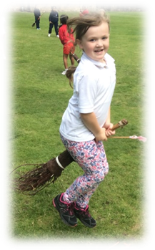
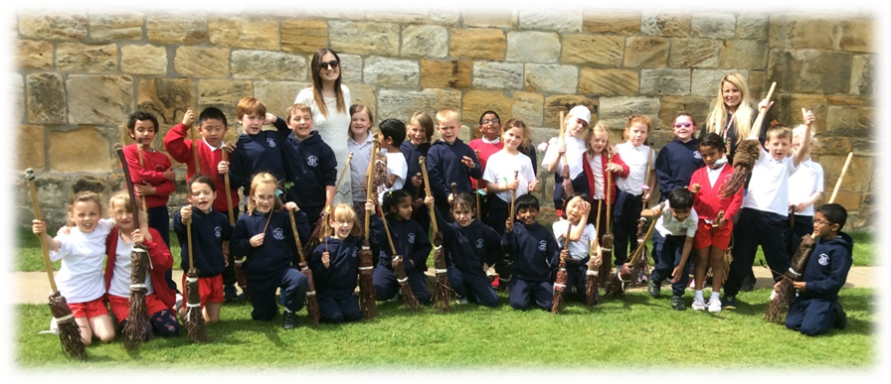
Harry Potter – By Dean, Olivia, Ava and Holly Y2
We have all really liked reading Harry Potter this year and have loved getting to know the characters. We had a fun experience in science making laughing potions during Science Week – it was really funny because it made us all laugh! We also loved making our own T.V adverts for magical objects and writing them into our books. It was amazing when Jenny came in to do some acting with us based on the parts of the book we had read so far; we had such a fun time! We also had a fantastic trip to Alnwick and all of Year 2 loved it. We made our own wands, took part in a magical story telling lesson and we had a tour of Alnwick Castle from Lady Rosie. At the end of the day we even got to have a flying lesson on broomsticks – we didn’t fly very high but it was really fun!

Slide 15
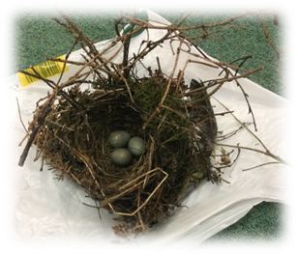
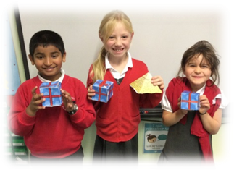
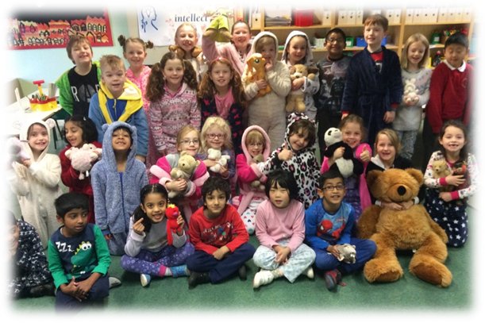
Interesting Lessons – by Katie, Linnet and Emma Y2
We have loved cooking this year and have made French biscuits on World Book Day and delicious smoothies during Health Week. We have also loved learning to tell the time this year. We enjoyed having the big clock on the carpet and
making our own mini clocks to help us in lessons. It was quite tricky learning quarter past and
quarter to but we said ‘yes I can’
and now we can do it!

Slide 16
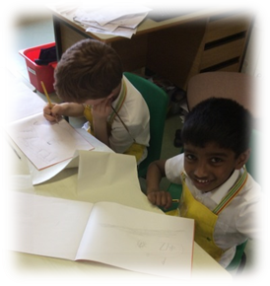
Shakespeare – by Martha, Tabitha and Katherine Y2
We really liked learning about The Tempest this year because there are loads of different characters. We love Shakespeare and it was great when an artist came in and taught us how to paint pictures based on the characters – we had to paint all of the characters!
We have also studied a Midsummer Night’s Dream, we have loved writing letters from Lysander to Helena and we were really good at understanding who was in love and who wasn’t.

Slide 17
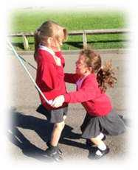
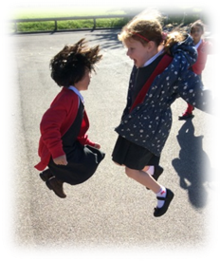
Super Skipping – by Alice, Andrew and Gabriel Y2
We had a fantastic day at the Skipping Festival, it took us a long time to walk there but we didn’t give up! We won lots of certificates and we had
a really fun day seeing all of the children from the other schools.

Slide 18
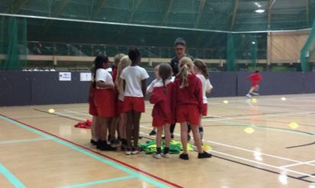
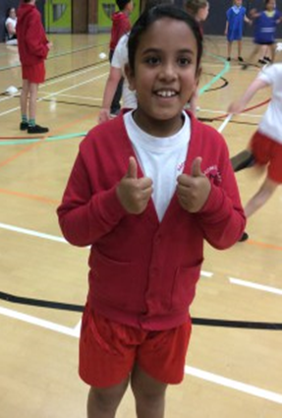
Walker dome
We visited Walker dome and played lots of fun games including dodgeball, bench ball and volley ball. We met lots of children from other schools and made good friends with them. By Pippa, Julia and William Y3

Slide 19
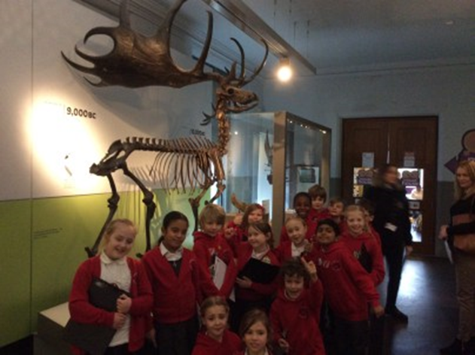
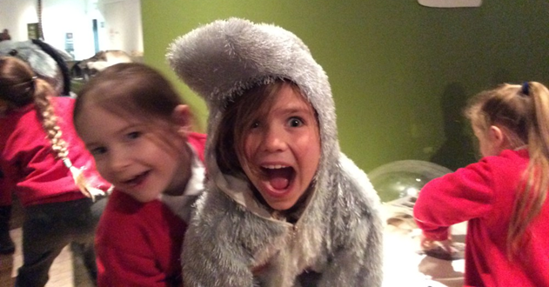
Great North Museum
We went to the Great North Museum and looked at lots of different Roman artefacts. We dressed up in different costumes and walked the length of a mini Hadrian’s Wall. After lunch, we explored the rest of the museum including the Bones exhibition. They had lots of skeletons from birds, mammals and even dinosaurs! We also saw real life snakes and lizards in the Nature area. By Finlay, Alfie and Christa Y3

Slide 20
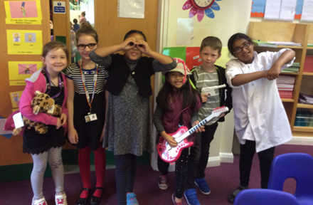
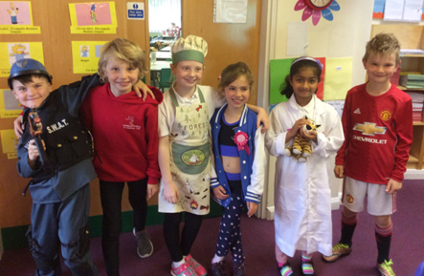
Dream Job Day
On dream job day, we dressed up as what we wanted to be when we grow up. We were visited by a Sports Journalist who taught us all about his job. It sounded amazing! We will look out for pieces written by him the next time we are reading a newspaper! By Paul, Serren, Lennon and Luke Y3

Slide 21
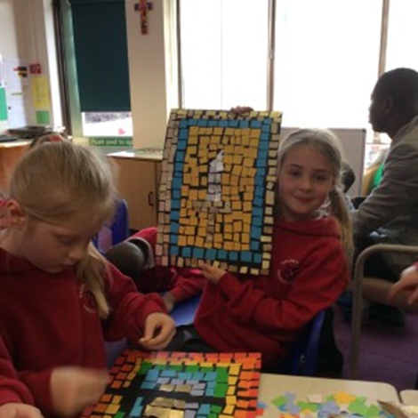
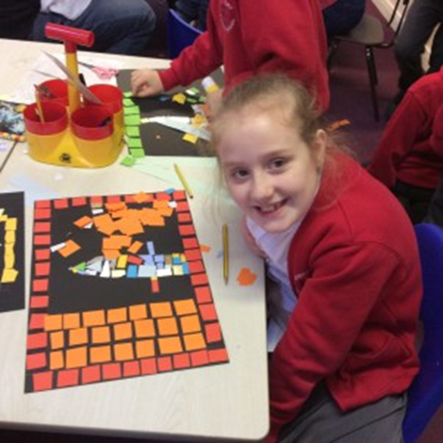
Roman Art Day
Our parents came to school for the afternoon and together we made our own Roman mosaics and clay coins. Tally and Maddison Y4

Slide 22
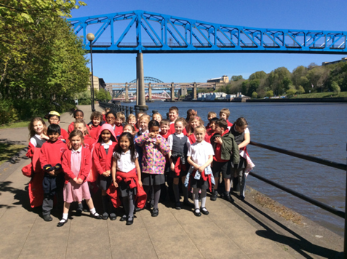
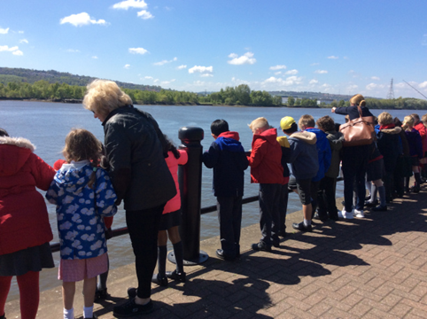
Walk along the Quayside
We went on the school mini buses to the Quayside. We walked along the Quayside and looked out for different attractions and activities. We spotted men fishing, cyclists, the Sage, Baltic and different cafes. In English, we wrote a persuasive advert about the Quayside. By Anna, Maddison, Aimee and Michael Y3

Slide 23
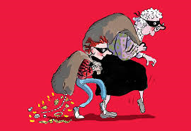
Gangsta Granny
We went to Sunderland Empire to watch Gangsta Granny by David Walliams. The actors and actresses were amazing, they had brilliant costumes and there was lots of movement on stage. We went on a big coach there and back which was very exciting! The bus driver was very friendly and kind. We loved it so much that we want to go back and watch it again!
By Lucas, Jessica, Tally and Mia.

Slide 24
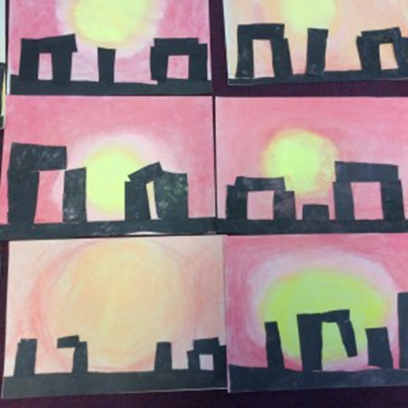
Stone Age Day
The school was in shock as we all came to school dressed up as people from the Stone Age. We made our own dens outside, shot bow and arrows, made clay necklaces and ate tasty smores. In the school garden, we took part in an archaeological exaction and found real bones! In class we inspected the bones and decided they all came from animals. By Daisy, Aidan and Alan Y3

Slide 25
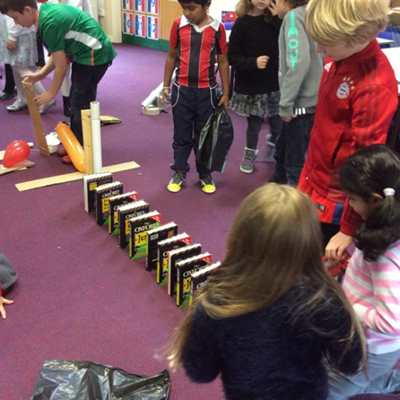
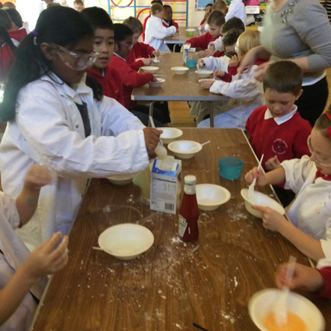
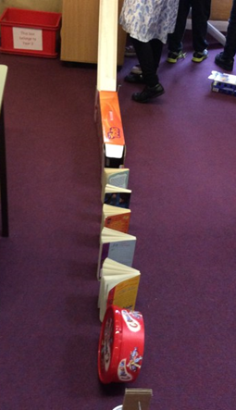
STEM Week in Year 3
We designed and built our own Rube Goldberg machines. The machines had to pop a balloon, and they were all successful! We even skyped Rube Goldberg’s grand-daughter and interviewed her. Finally, Mr Peel came in and taught us about bridges and stability/balance. We made bridges out of paper and dictionaries. By Oliver and David.

Slide 26
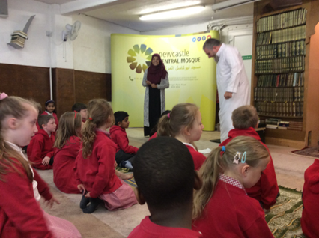
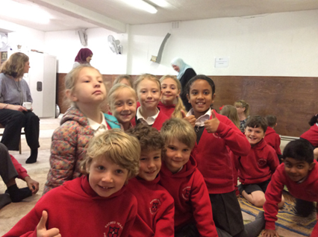
Magnificent Mosque
We went to Newcastle Central Mosque and it was really fun and exciting. The people at the Mosque were so kind and caring. They showed us different copies of the Qu’ran, how they pray and pictures of famous Mosques around the world. We also went on a pilgrimage to Mecca!
By Ciara, Alisha
and Emily Y3

Slide 27
Science Week
In Science week, we were visited by Scientists from Newcastle University. They taught us about the different types of Scientists. We didn’t realise there were so many! Did you know? Not all Scientists have fuzzy hair and glasses! After our lessons, we watched ‘The Story of the Earth show’ which was all about the solar system. We made our own projects and a teacher from the high school chose the best project from each class. By Alvin and Livia Y3

Slide 28
Youth Village
In Year 3, we went to the Youth Village in Consett. We stayed there for two days and 1 night. When we got there, we watched an epic movie –Turbo. We played lots of fun games. The games helped us to learn about Jesus. We created our own collage of Jesus and sang a song called ‘Lighthouse.’ We can’t wait to go back next year! By Kimberly and Angel.

Slide 29
Health Week
We loved health week! We made vegetable pizzas and fruit salads. We all tried a new fruit. The most popular fruit was mango! We also practised skipping with the Year 4 children.

Slide 30
Going to Sacred Heart High school to see some animals.
When we went to Sacred Heart High school we saw a mixture of animals. We passed them all around the circle we were in. There were about ten animals’ altogether. The snake wasn’t slimy and we saw the dead skin of it. There was even a meer cat and it stood up. We were all very excited by that, then we saw the second biggest snails in the world. There were some gentle animals as well such as, a tarantula, a lizard, a hedgehog and a cockroach. By Jacob Neillis Y4

Slide 31
Book Fair
During Lent Y4 had a book fair. What we did was we needed to find some old books and bring them in to school so people can read different books that they have never read before. Also we wanted to have this book fair because we wanted to support the Marie Curie charity, it is a place for people who have cancer and that can be treated well . Lots of people in year 4 helped to raise money for them. It is a good way to recycle books if they don’t want them.
The people who helped with the book fair was Arthur, Giana, Julienne , Aleigha, Lince, Ilaria ,Katie, Rocco and Luke.
By Julienne Y4

Slide 32
The Centre for LIFE
In year 4 we went to the Centre for Life. We checked in first at reception. Then we were in the Curiosity Zone. The things we did were DJ-ing, spinning wheels, making marble runs and putting our skin against ice which then would be red on a heat camera. Then we were watching a show about caterpillars and how they shoot waste to avoid being prey. Next we did an experiment on woodlice, where we found out that woodlice like wet and dark habitats the best. After that we had lunch. The highlight of the day was ice skating! When we ice skated we had a quick lesson then we just skated for about an hour. Next we had a brief look at the exhibition
which was called ‘Animals Inside Out’.
Finally we went on a 4D
motion ride which was, at the time,
‘Journey 2: Ride over Atlantis’.
At the Centre for Life we all had an
amazing time! By Luke Nevins Y4

Slide 33
The Easter Play
Before the Easter holiday’s year 3 and 4 performed an Easter Play. It was the story of Jesus. First we practised some songs; there were four songs which we enjoyed. Then we practised the play. Instead of doing it on the stage we had cones around the hall because we needed lots of people and the stage was not that big. We practised a lot of times and it was hard work. It wasn’t really good at the start because some people didn’t know their lines but then when we practised and practised, we had a ‘yes I can’ attitude and we all knew our lines which was amazing. Then we had a dress rehearsal with our costumes which we liked. After we got some objects like the cross, a blanket to cover the table for the last supper and we had more! Then…it was time to do the play so we got ready. We did two plays one
for school and the other one for parents.
When we finished everyone said that it was a
really good play. We were really proud.
We also thank the teachers for organising the
play. By Artur Piecuch Y4

Slide 34
The Electric Vehicle Competition
Eight children from Year 4 entered an electric vehicle
competition. Giana, Luke, Ameya and Rocco were one team, while Daniel, Christopher, Lince and Siyona were the other. There were two competitions in one and they were both hosted at St Cuthbert’s. The whole point of the competition was to encourage people to buy electric cars to help the environment. At the first competition we talked to some scientists from Newcastle University and the St Cuthbert’s green team. Then the actual competitive bit was when our school and the other schools had to make a car that ran on balloon air. They made it out of skewers, card, one balloon, straw, and CDs. The children didn’t win it but they kept on trying which helped a lot in the next competition. Later on in the year there was the next competition where we had to make a comic to do with electric cars. We then brought it in to show the judges my team WON first place. We got a small solar powered car and a wind and water toy which we enjoy playing with. We are so very proud of our children and hope they continue to love STEM. By Giana Y4

Slide 35
The Mayor of Newcastle
Children from the School Council went to the Civic centre to see the Mayor of Newcastle. It was when the school council had their first trip together, we got to see some of England’s greatest treasures. There were lots of cool things like a Battle Axe, Medals and lots of special rewards. The Mayor was a female and she was really nice and lovely. We also got to see a train that was a poster, but it was the first ever train from Newcastle. The coolest item was probably the Battle axe at the back of the room. The most fascinating items were the coins from Marks and Spencer when it first opened up. The fun fact is that the Mayor changes place with someone else when the year ends. We also got a little plastic medal for us to remember this occasion. Over all it was really awesome. By Alex Y4

Slide 36
The Tempest Art
A lovely artist came in and demonstrated ink colours and how to use them on card. We made sketches of the tempest and coloured it in, and we used crayons. Apparently, crayons react to the ink when you drop some ink onto something sketched out with a crayon. The tempest originated from the old Shakespeare book. We also drew in our sketch books to see what it would look like. This was really fun. The woman who helped us to draw was very nice and very helpful. I want her to come back some time. On BBC bite size, they had episodes of the Tempest and we watched half them in a week, but really I had a fun time with the artist. By Evie Y4

Slide 37
Vegetable Pizzas
As part of Health Week we made vegetable pizzas.
We had tomato sauce on our pitta breads and the
vegetables we had to choose from were: peppers, sweetcorn,
chilli peppers, mushrooms, tomatoes, courgette and pineapple.
After Miss Ward had explained everything, we got a sheet of paper with an oval shape on we had to plan what vegetables we wanted and it was also an idea of what we wanted. Mrs Ferguson was at our table, but before we could do anything we had to wash our hands. The first people at the table opened all of the packets of vegetables and put them into separate bowls. We had our pitta bread, we smoothed it in tomato sauce. Next Mrs Ferguson showed us out to cut the vegetables we wanted. Each table got to have a go at cutting the vegetables for their pizza. After we were done we made a face with them with our sheet to help us. So when we were done we gave it to Mrs Ferguson so she put it in the oven. When we took one bite out of it was very tasty!!! Thanks Mrs Ferguson they were tasty as I said they would be. By Rocco Y4

Slide 38
Harry Potter Day
This year we have enjoyed taking part in
Harry Potter’s 20th anniversary. On the
morning of this celebration people came in
dressed as their favourite character from
Harry Potter. From quizzes to quiditch our
day was jam-packed with magical mayhem.
It even inspired some people to go home and read some Harry Potter books. We interviewed Emily; she said “I loved it because it inspired me to become a Harry Potter fan. It was a dazzlingly marvellous extravaganza, and we hope to have it next year!!
By Meghan Worland, Francesca Terente , Ava Rose Cloet De Giorgi and Charlotte Grant. Y5

Slide 39
Borrowdale
Year 5 moved away from city life and went into the country life, in a wonderful place called Borrowdale. Many conquered their fears during Treetop Trek when we went on a big zip wire. Another activity was ghyll scrambling in a river full of rocks, many were worried about climbing up the waterfall, and they thought they might slip off. Canoeing was one of the funniest activities, everyone was falling off the boat. One person got trapped under the boat when it tipped over but we still had a little laugh. The hardest one was the long walk, when we finally reached there it felt like it took a life time but it was a great achievement. The place we stayed was really good, everyone was really nice there. One of our teachers told us a scary story. We all loved Borrowdale, it was an amazing experience for all of us to face our fears!
By Althea Hismana, Makayla Langan,
Mason Morris, Alice Thorley,
Dania Varghese and Neve WallaceY5

Slide 40
London
At the start of the year we went to London where we saw lots of amazing things. Some activities we did were: going on the London Eye, watched Wicked and visited Harry Potter land. London was a great opportunity to get the feel of being in year 6. We had time to bond with our year 6 teachers; Mrs Nesbit and Mrs Nelson. We met Chi Onwarah our local MP at the Houses of Parliament. By Megan Y6

Slide 41
Our Holy Island trip was amazing! We went with our year 6 teachers and Miss Spark. Everyone was reverent and peaceful. All of us made our own mark on the beach. I made a sign saying Love. Also, everyone got the chance to make speeches for if they wanted to be: a School Councillor, Head Girl , Head Boy, Deputy Head Boy or Deputy Head Girl. I did my speech to become head girl at school because I didn’t think I was ready at Holy Island. Surprisingly, I became Head Girl and Alan became Head Boy. Jessica is Deputy Head Girl and Matthew is Deputy Head Boy. By Fiona Y6

Slide 42
Virgin Money
During Christmas time, we got to do a Virgin Money project . This project was all about selling Christmas -related homemade items, to sell to the public at the Grainger Market. Miraculously, we raised £400!!!!
By Abigail Y6

